Slide 1
CAP4770 Project Proposal Final Presentation
Matthew Strenges
Tuyet Phan
Mary Szabo

Slide 2
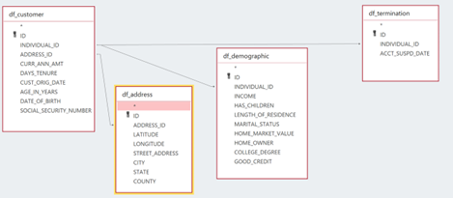
Recap
Obtained an auto insurance company dataset
2,280,321 unique customers
269,259 customers canceled their policies
Cleaned the data: filled in missing data point with mean for numerical values and mode for categorical values
Eliminated trivial attributes, 11 were used for analysis
Implemented Decision Tree and Random Forest models for three types of datasets: (1) processed data, (2) oversampling data, and (3) undersampling data and compared results
Calculated accuracy, recall, precision, F1-score, ROC curve, AUC, and confusion matrices

Slide 3
Details of Tools & Approaches
Import libraries and modules such as:
pylab, matplotlib, pandas, numpy
imbalanced-learn: perform random sampling using the RandomOverSampler class
sklearn.tree: create a Decision Tree Classifier and display its plot
sklearn.model_selection: train_test_split, RandomizedSearchCV, train_test_split
sklearn.ensemble: RandomForestClassifier – create Random Forest model
sklearn.metrics:
(1) classification_report – gives values for accuracy, precision, recall, f1-score, and support
(2) ConfusionMatrixDisplay, confusion_matrix
(3) roc_curve – display ROC curve for Decision Tree & Random Forest of the processed data, oversampling data, and undersampling data
seaborn: display feature importance for Random Forest model
scipy.stats: randint
IPython.display: Image

Slide 4
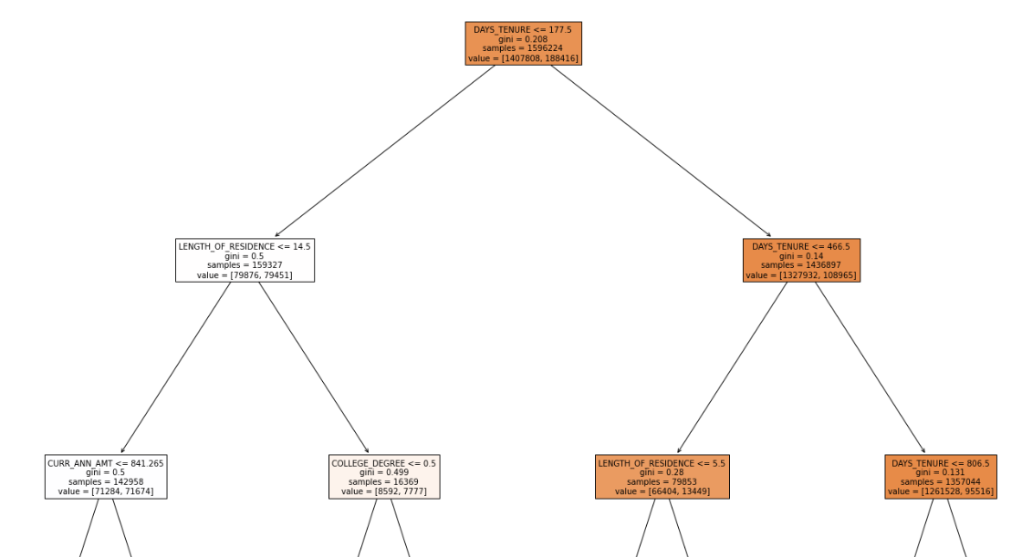
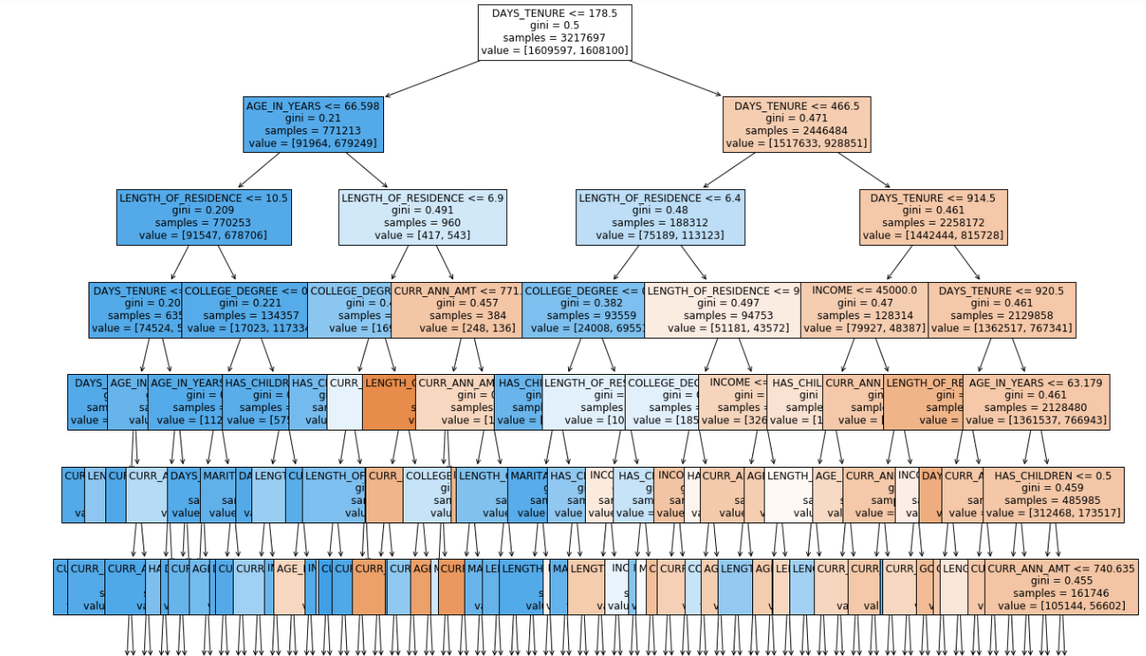
Results: Visualization of Decision Trees
Processed dataset
Oversampling dataset
max_depth = 2
max_depth = 6

Slide 5
Results: Accuracy for Classification Models
 | Decision Tree | Random Forest
Processed | 82 % | 88 %
Oversampling | 94 % | 88 %*
Undersampling | 60% | 68%
Note: Randomly sampled 10% of the data for faster testing (402212 datapoints)

Slide 6
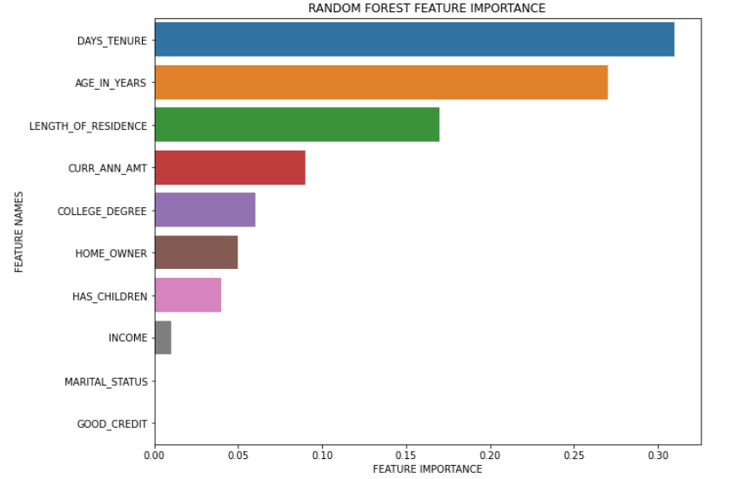
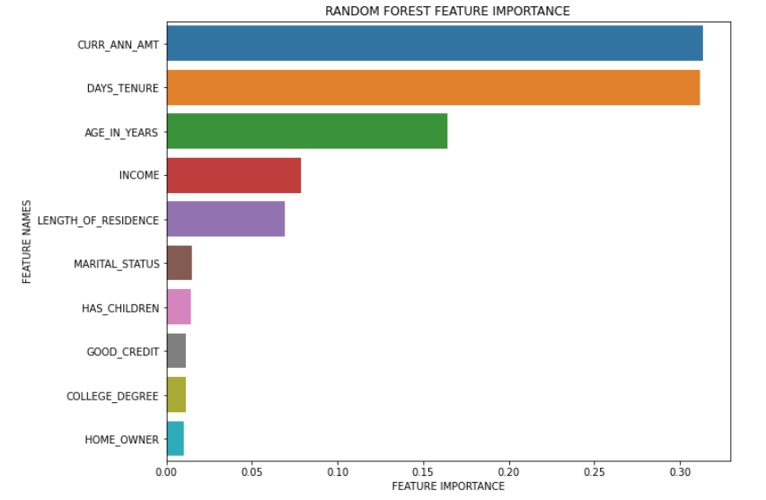
Results: Feature Importance
processed
Oversampling

Slide 7
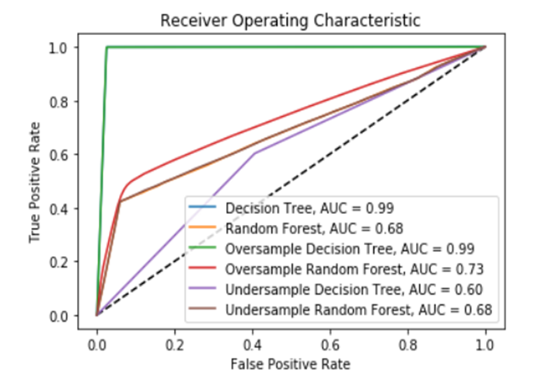
Result: ROC Curve

Slide 8
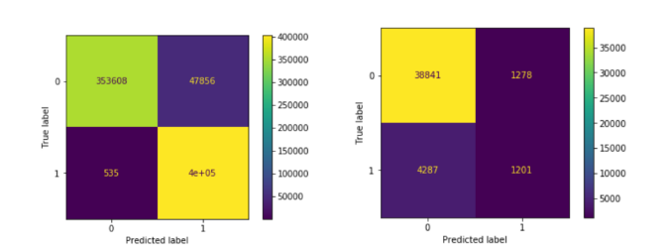
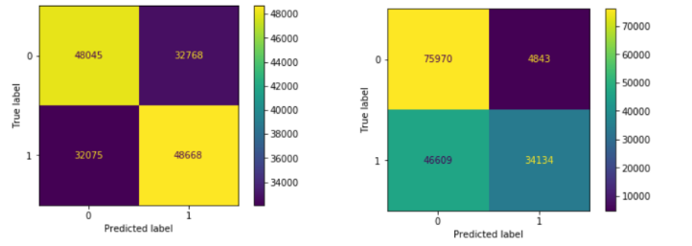
Results: Confusion Matrix
Oversampling
undersampling
Decision Tree Random Forest
Decision Tree Random Forest

Slide 9
Conclusion
Decision Tree classifier using oversampling yielded the highest accuracy
The top three attributes that contribute to customer churn are:
Tenure
Age
Length of residence

